Slide 1
CSCE 5580 – Computer Networks Instructor: Tao Wang

Slide 2

Transport layer: roadmap
Transport-layer services
Multiplexing and demultiplexing
Connectionless transport: UDP
Principles of reliable data transfer
Connection-oriented transport: TCP
Principles of congestion control
TCP congestion control
Evolution of transport-layer functionality

Slide 3








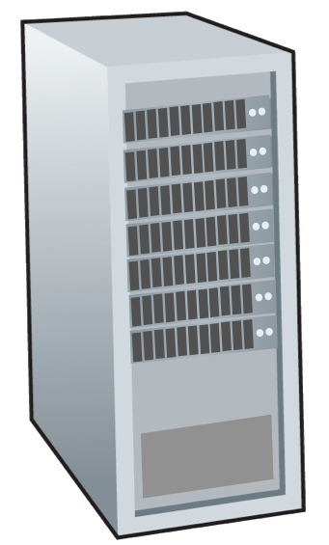







Transport services and protocols
application
transport
network
data link
physical
provide logical communication between application processes running on different hosts
mobile network
national or global ISP
transport protocols actions in end systems:
sender: breaks application messages into segments, passes to network layer
receiver: reassembles segments into messages, passes to application layer
logical end-end transport
local or regional ISP
home network
content
provider
network
application
transport
network
data link
physical
datacenter
network
two transport protocols available to Internet applications
TCP, UDP
enterprise
network
Notes:
The header in the transport layer is the port number, that is used to identify an application in the system.
We have different transport layer protocols for IOT devices.

Slide 4
Transport Layer Actions
Sender:
application
application
is passed an application-layer message
app. msg
determines segment header fields values
T_{h}
transport
app. msg
transport
T_{h}
creates segment
network (IP)
network (IP)
passes segment to IP
link
link
physical
physical
Notes:
Each message will have its unique port number (It has source and destination port numbers).

Slide 5
Transport Layer Actions
Receiver:
application
receives segment from IP
application
checks header values
transport
transport
app. msg
extracts application-layer message
network (IP)
network (IP)
demultiplexes message up to application via socket
link
link
physical
physical
app. msg
T_{h}

Slide 6
Two principal Internet transport protocols
application
transport
network
data link
physical
TCP: Transmission Control Protocol
reliable, in-order delivery
congestion control
flow control
connection setup
UDP: User Datagram Protocol
unreliable, unordered delivery
no-frills extension of “best-effort” IP
services not available:
delay guarantees
bandwidth guarantees
mobile network
national or global ISP
logical end-end transport
local or regional ISP
home network
content
provider
network
application
transport
network
data link
physical
datacenter
network
enterprise
network
Notes:
Reliable: Packet arrived without error in proper order.
Flow control: Make sure the packet does not overflow the receiver.
UDP is simpler than TCP.

Slide 7
Chapter 3: roadmap
Transport-layer services
Multiplexing and demultiplexing
Connectionless transport: UDP
Principles of reliable data transfer
Connection-oriented transport: TCP
Principles of congestion control
TCP congestion control
Evolution of transport-layer functionality

Slide 8

Multiplexing/demultiplexing
multiplexing as sender:
demultiplexing as receiver:
handle data from multiple
sockets, add transport header (later used for demultiplexing)
use header info to deliver
received segments to correct
socket
application
application
P1
P2
application
socket
P3
transport
P4
process
transport
network
transport
network
link
network
link
physical
link
physical
physical
Notes:
Multiplexing is done by the sender.

Slide 9




HTTP server
client
application
application
HTTP msg
transport
H_{t}
HTTP msg
H_{n}
H_{t}
network
transport
HTTP msg
transport
H_{n}
H_{t}
link
network
network
HTTP msg
link
physical
link
physical
physical
H_{n}
H_{t}
HTTP msg
Notes:
When sending a packet then we need to make sure the application sends the correct port number.
We need combination of port number (to identify different applications) and IP address (to identify different clients)

Slide 10

Q: how did transport layer know to deliver message to Firefox browser process rather than Netflix process or Skype process?
client
application
application
HTTP msg
HTTP msg
transport
H_{t}
HTTP msg
transport
network
transport
network
link
network
link
physical
link
physical
physical

Slide 11
application
?
transport
de-multiplexing

Slide 12
application
transport
multiplexing

Slide 13
How demultiplexing works
host receives IP datagrams
each datagram has source IP address, destination IP address
each datagram carries one transport-layer segment
each segment has source, destination port number
host uses IP addresses & port numbers to direct segment to appropriate socket
32 bits
source port #
dest port #
other header fields
application
data
(payload)
TCP/UDP segment format
Notes:
Right image is common for segment format.
TCP has a much larger overhead.

Slide 14
Connectionless demultiplexing
Recall:
when creating socket, must specify host-local port #:
DatagramSocket mySocket1 = new DatagramSocket(12534);
when receiving host receives UDP segment:
checks destination port # in segment
directs UDP segment to socket with that port #
when creating datagram to send into UDP socket, must specify
destination IP address
destination port #
IP/UDP datagrams with same dest. port #, but different source IP addresses and/or source port numbers will be directed to same socket at receiving host
Notes:
Don’t need to establish a connection (basically means UDP).
We only care about the destination and don’t care about the source.

Slide 15
Connectionless demultiplexing: an example
mySocket = socket(AF_INET,SOCK_DGRAM)
mySocket.bind(myaddr,6428);
mySocket = socket(AF_INET,SOCK_STREAM)
mySocket.bind(myaddr,9157);
mySocket = socket(AF_INET,SOCK_STREAM)
mySocket.bind(myaddr,5775);
application
application
P1
application
P3
P4
transport
transport
network
transport
network
link
network
link
physical
link
physical
physical
B
D
source port: 6428
dest port: 9157
source port: ?
dest port: ?
A
C
source port: 9157
dest port: 6428
source port: ?
dest port: ?
Notes:
This is UDP
P3, P4 – sender.
P1 – receiver.
Note: We always have large port numbers because small port numbers are already taken.
Packets go to the same socket as the destination port is same.

Slide 16
Connection-oriented demultiplexing
TCP socket identified by 4-tuple:
source IP address
source port number
dest IP address
dest port number
server may support many simultaneous TCP sockets:
each socket identified by its own 4-tuple
each socket associated with a different connecting client
demux: receiver uses all four values (4-tuple) to direct segment to appropriate socket
Notes:
The packets here will go it different sockets if it has different port numbers (1 tuple is different it will go to different sockets).

Slide 17
Connection-oriented demultiplexing: example
application
application
P4
P5
P6
application
P1
P2
P3
transport
transport
network
transport
network
link
network
link
physical
link
physical
server: IP address B
physical
host: IP address A
source IP,port: B,80
dest IP,port: A,9157
host: IP address C
source IP,port: C,5775
dest IP,port: B,80
source IP,port: A,9157
dest IP, port: B,80
source IP,port: C,9157
dest IP,port: B,80
Three segments, all destined to IP address: B,
dest port: 80 are demultiplexed to different sockets
Notes:
This is TCP.
80 means it’s a web service.
If we have 100 clients, then we need 100 sockets/process.

Slide 18
Summary
Multiplexing, demultiplexing: based on segment, datagram header field values
UDP: demultiplexing using destination port number (only)
TCP: demultiplexing using 4-tuple: source and destination IP addresses, and port numbers
Multiplexing/demultiplexing happen at all layers

Slide 19
Chapter 3: roadmap
Transport-layer services
Multiplexing and demultiplexing
Connectionless transport: UDP
Principles of reliable data transfer
Connection-oriented transport: TCP
Principles of congestion control
TCP congestion control
Evolution of transport-layer functionality

Slide 20
UDP: User Datagram Protocol
Why is there a UDP?
“no frills,” “bare bones” Internet transport protocol
“best effort” service, UDP segments may be:
lost
delivered out-of-order to app
no connection establishment (which can add RTT delay)
simple: no connection state at sender, receiver
small header size
no congestion control
UDP can blast away as fast as desired!
can function in the face of congestion
connectionless:
no handshaking between UDP sender, receiver
each UDP segment handled independently of others
Notes:
No overhead, it's simple.
Does not provide reliable service (If the packet is lost then it is gone).
Benefit- It's connectionless- no handshaking – no connection establishment.
No sequence numbers unlike TCP.

Slide 21
UDP: User Datagram Protocol
UDP use:
streaming multimedia apps (loss tolerant, rate sensitive)
DNS
SNMP
HTTP/3
if reliable transfer needed over UDP (e.g., HTTP/3):
add needed reliability at application layer
add congestion control at application layer

Slide 22
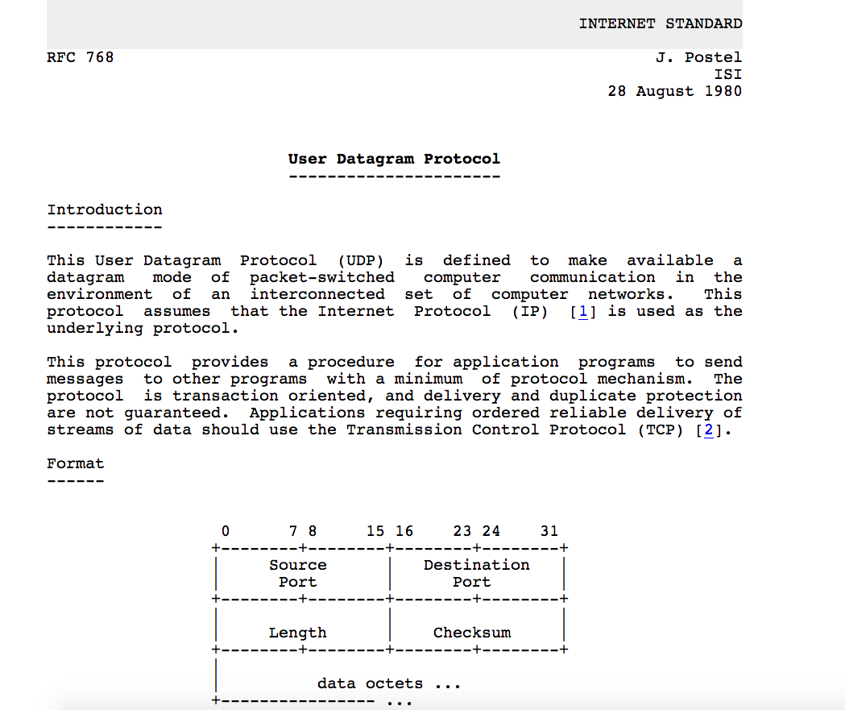
UDP: User Datagram Protocol [RFC 768]
Notes:
read this RFC – it’s only 2.5 pages!
Length – Indicate the size of the package
Checksum – Used to check the integrity.

Slide 23
UDP: Transport Layer Actions
SNMP client
SNMP server
application
application
transport
(UDP)
transport
(UDP)
network (IP)
network (IP)
link
link
physical
physical

Slide 24
UDP: Transport Layer Actions
SNMP client
SNMP server
UDP sender actions:
application
application
is passed an application-layer message
SNMP msg
transport
(UDP)
transport
(UDP)
determines UDP segment header fields values
UDP_{h}
SNMP msg
UDP_{h}
creates UDP segment
network (IP)
network (IP)
passes segment to IP
link
link
physical
physical

Slide 25
UDP: Transport Layer Actions
SNMP client
SNMP server
UDP receiver actions:
application
receives segment from IP
application
checks UDP checksum header value
transport
(UDP)
transport
(UDP)
SNMP msg
extracts application-layer message
network (IP)
network (IP)
SNMP msg
UDP_{h}
demultiplexes message up to application via socket
link
link
physical
physical

Slide 26
UDP segment header
32 bits
source port #
dest port #
length
checksum
application
data
(payload)
length, in bytes of UDP segment, including header
data to/from application layer
UDP segment format
Notes:
UDP socket is identified by only the destination IP address and destination port number, no need for source information.

Slide 27

UDP checksum
Goal: detect errors (i.e., flipped bits) in transmitted segment
1st number
2nd number
sum
Transmitted: 5 6 11
Received: 4 6 11
receiver-computed
checksum
=
sender-computed
checksum (as received)
Notes:
Verify the integrity.
11 is the checksum.
Put 11 as the last element.
The checksum is different, so the receiver will discard the packet.
In packets it not integer, its bit sequence. So we add bit sequence to get the checksum.

Slide 28
Internet checksum
Goal: detect errors (i.e., flipped bits) in transmitted segment
sender:
treat contents of UDP segment (including UDP header fields and IP addresses) as sequence of 16-bit integers
checksum: addition (one’s complement sum) of segment content
checksum value put into UDP checksum field
receiver:
compute checksum of received segment
check if computed checksum equals checksum field value:
not equal - error detected
equal - no error detected. But maybe errors nonetheless? More later ….

Slide 29
Internet checksum: an example
example: add two 16-bit integers
1 1 1 0 0 1 1 0 0 1 1 0 0 1 1 0
1 1 0 1 0 1 0 1 0 1 0 1 0 1 0 1
wraparound
1 1 0 1 1 1 0 1 1 1 0 1 1 1 0 1 1
sum
1 0 1 1 1 0 1 1 1 0 1 1 1 1 0 0
checksum
0 1 0 0 0 1 0 0 0 1 0 0 0 0 1 1
Note: when adding numbers, a carryout from the most significant bit needs to be added to the result
Notes:
Add the extra bit to the remaining bits.

Slide 30
Internet checksum: weak protection!
example: add two 16-bit integers
0 1
1 1 1 0 0 1 1 0 0 1 1 0 0 1 1 0
1 0
1 1 0 1 0 1 0 1 0 1 0 1 0 1 0 1
wraparound
1 1 0 1 1 1 0 1 1 1 0 1 1 1 0 1 1
Even though numbers have changed (bit flips), no change in checksum!
sum
1 0 1 1 1 0 1 1 1 0 1 1 1 1 0 0
checksum
0 1 0 0 0 1 0 0 0 1 0 0 0 0 1 1
Notes:
A checksum is a basic way to check the integrity; it has redundancy. Because if the bits are flipped. As shown above, the checksum is still the same.

Slide 31
Question
Alice developed a message authentication code (MAC) based on DES. Her algorithm works as follows: For a given input message M, represent M as M = (X1 || X2 || ... || Xm), where Xi is a 64-bit block and || represents concatenation. Compute Delta(M) = X1 ^ X2 ^ ... ^ Xm, where ^ represents bit-wise XOR. Then the MAC for M is computed as CK(M) = EK(Delta(M)), where E is DES encryption algorithm and K is the secret key. Unfortunately, this scheme is vulnerable. Describe an attack against it.
Notes:
DES: Encryption scheme.
|| : concatenation
Message is divided into blocks; each block is 64 bits.
Exclusive Or (XOR) is it almost like a checksum?
Delta(M) = x1^x2^x3….^xm result is 64 bit block
We cannot change the encrypted result (EK(Delta(M)).
Message is not encrypted.
M, MAC
Ans: We cant change MAC because it is encrypted, but we can change message M.
Flip both the bits for x1 and x2 and x3,…. And make sure XOR result is same.
Ex 0 xor 1 is 1. If we flip 1 xor 0 is also 1.

Slide 32
Summary: UDP
“no frills” protocol:
segments may be lost, delivered out of order
best effort service: “send and hope for the best”
UDP has its plusses:
no setup/handshaking needed (no RTT incurred)
can function when network service is compromised
helps with reliability (checksum)
build additional functionality on top of UDP in application layer (e.g., HTTP/3)
Notes:
Advantages:
We don’t need a handshake (no connection) hence Reducing overhead.

Slide 33
Chapter 3: roadmap
Transport-layer services
Multiplexing and demultiplexing
Connectionless transport: UDP
Principles of reliable data transfer
Connection-oriented transport: TCP
Principles of congestion control
TCP congestion control
Evolution of transport-layer functionality

Slide 34
Principles of reliable data transfer
sending process
receiving process
application
data
data
transport
reliable channel
reliable service abstraction
Notes:
Reliable: Everything is received correctly and in order.

Slide 35
Principles of reliable data transfer
sending process
receiving process
sending process
receiving process
application
data
data
application
data
data
transport
transport
reliable channel
sender-side of
reliable data transfer protocol
receiver-side
of reliable data transfer protocol
reliable service abstraction
transport
network
unreliable channel
reliable service implementation
Notes:
If we find a package that is corrected or lost, it will inform the transmitter to re-transmit that particular packet.

Slide 36
Principles of reliable data transfer
sending process
receiving process
application
data
data
transport
sender-side of
reliable data transfer protocol
receiver-side
of reliable data transfer protocol
Complexity of reliable data transfer protocol will depend (strongly) on characteristics of unreliable channel (lose, corrupt, reorder data?)
transport
network
unreliable channel
reliable service implementation

Slide 37
What do we need for reliable data transfer

Slide 38
Reliable data transfer protocol (rdt): interfaces
rdt_send(): called from above, (e.g., by app.). Passed data to deliver to receiver upper layer
deliver_data(): called by rdt to deliver data to upper layer
sending process
receiving process
rdt_send()
data
data
deliver_data()
data
sender-side
implementation of rdt reliable data transfer protocol
receiver-side
implementation of rdt reliable data transfer protocol
packet
udt_send()
Header
data
Header
data
rdt_rcv()
unreliable channel
udt_send(): called by rdt
to transfer packet over
unreliable channel to receiver
rdt_rcv(): called when packet arrives on receiver side of channel
Bi-directional communication over unreliable channel
Notes:
To transfer the package reliability the application will call rdt_send().
Udt_send(): Unreliable – Service provided by lower level like network layer.
We want reliability, but we get unreliable by the network layer.
Senders have algorithms to send reliable packets via unreliable channels.
Reciever will have algorithm to check the package reliability. If everything is correct then the data is extracted and sent up.

Slide 39
Reliable data transfer: getting started
We will:
incrementally develop sender, receiver sides of reliable data transfer protocol (rdt)
consider only unidirectional data transfer
but control info will flow in both directions!
use finite state machines (FSM) to specify sender, receiver
event causing state transition
actions taken on state transition
state: when in this “state” next state uniquely determined by next event
state
1
state
2
event
actions
Notes:
If we want to implement some methods, we need to make sure the packet is reliable and in proper order.
Action: move from one state to other what function we will call (function to send out packet?, etc)

Slide 40

rdt1.0: reliable transfer over a reliable channel
underlying channel perfectly reliable
no bit errors
no loss of packets
separate FSMs for sender, receiver:
sender sends data into underlying channel
receiver reads data from underlying channel
Wait for call from above
rdt_send(data)
Wait for call from below
rdt_rcv(packet)
sender
packet = make_pkt(data)
udt_send(packet)
receiver
extract (packet,data)
deliver_data(data)
Notes:
Rdt1.0: Only one packet at a time is sent.
We have separate machines for sender and receive.
Sender:
When we got a message from the application, we went back to the wait state.
We don’t need to take feedback. After all, we know it will get because we are sending 1 packet at a time.
Received:
Since it’s a reliable channel, we don’t need to send the feedback because everything is perfect.

Slide 41
rdt2.0: channel with bit errors
underlying channel may flip bits in packet
checksum (e.g., Internet checksum) to detect bit errors
the question: how to recover from errors?
Notes:
It's unreliable, and we assume we have bit errors.
If we have a bit of error, then transmit the correct packet.
Whenever the packet is received, it will send feedback, which will tell whether the packet is received correctly or if we need a re-transmission.

Slide 42
rdt2.0: channel with bit errors
underlying channel may flip bits in packet
checksum to detect bit errors
the question: how to recover from errors?
acknowledgements (ACKs): receiver explicitly tells sender that pkt received OK
negative acknowledgements (NAKs): receiver explicitly tells sender that pkt had errors
sender retransmits pkt on receipt of NAK
stop and wait
sender sends one packet, then waits for receiver response
Notes:
If ACK, the sender will move to the next state, and if NAK, the sender will retransmit.
The sender will wait for the feedback.
Here, also, we only send one packet at a time, with no pipeline.

Slide 43
rdt2.0: FSM specifications
rdt_send(data)
snkpkt = make_pkt(data, checksum)
udt_send(sndpkt)
rdt_rcv(rcvpkt) &&
isNAK(rcvpkt)
sender
Wait for call from above
Wait for ACK or NAK
udt_send(sndpkt)
rdt_rcv(rcvpkt) && corrupt(rcvpkt)
udt_send(NAK)
rdt_rcv(rcvpkt) && isACK(rcvpkt)
Wait for call from below
Λ
receiver
rdt_rcv(rcvpkt) && notcorrupt(rcvpkt)
extract(rcvpkt,data)
deliver_data(data)
udt_send(ACK)
Notes:
Sender:ggttr
The sender will have two states.
snkpkt = make_pkt(data, checksum): Create a packetreliable.
udt_send(sndpkt): Send the packet via unreliable channel.
rdt_rcv(rcvpkt) && isACK(rcvpkt): This is from the receiver. If it's ACK, the packet has been received correctly, then we can move to next state.
Reciever:
In this algorithm, sender knows the state of receiver.

Slide 44

rdt2.0: FSM specification
rdt_send(data)
snkpkt = make_pkt(data, checksum)
udt_send(sndpkt)
rdt_rcv(rcvpkt) &&
isNAK(rcvpkt)
sender
Wait for call from above
Wait for ACK or NAK
isNAK(rcvpkt)
udt_send(sndpkt)
rdt_rcv(rcvpkt) && corrupt(rcvpkt)
udt_send(NAK)
rdt_rcv(rcvpkt) && isACK(rcvpkt)
isACK(rcvpkt)
Wait for call from below
Λ
receiver
Note: “state” of receiver (did the receiver get my message correctly?) isn’t known to sender unless somehow communicated from receiver to sender
that’s why we need a protocol!
rdt_rcv(rcvpkt) && notcorrupt(rcvpkt)
extract(rcvpkt,data)
deliver_data(data)
udt_send(ACK)
Notes:
Senders don’t need to know the state of the receiver.

Slide 45
rdt2.0: operation with no errors
rdt_send(data)
snkpkt = make_pkt(data, checksum)
udt_send(sndpkt)
rdt_rcv(rcvpkt) &&
isNAK(rcvpkt)
sender
Wait for call from above
Wait for ACK or NAK
udt_send(sndpkt)
rdt_rcv(rcvpkt) && corrupt(rcvpkt)
udt_send(NAK)
rdt_rcv(rcvpkt) && isACK(rcvpkt)
Wait for call from below
Λ
receiver
rdt_rcv(rcvpkt) && notcorrupt(rcvpkt)
extract(rcvpkt,data)
deliver_data(data)
udt_send(ACK)

Slide 46
rdt2.0: corrupted packet scenario
rdt_send(data)
snkpkt = make_pkt(data, checksum)
udt_send(sndpkt)
rdt_rcv(rcvpkt) &&
isNAK(rcvpkt)
sender
Wait for call from above
Wait for ACK or NAK
udt_send(sndpkt)
rdt_rcv(rcvpkt) && corrupt(rcvpkt)
udt_send(NAK)
rdt_rcv(rcvpkt) && isACK(rcvpkt)
Wait for call from below
Λ
receiver
rdt_rcv(rcvpkt) && notcorrupt(rcvpkt)
extract(rcvpkt,data)
deliver_data(data)
udt_send(ACK)
Notes:
Problem:
For this, we only consider the packet sent by the sender to be corrupt.
The packet(ACK or NAK) sent by the receiver can also be corrupt.
If the receiver sends NAK (corrupt), the sender will send the packet again. So, the receiver will get duplicate packets.

Slide 47
rdt2.0 has a fatal flaw!
what happens if ACK/NAK corrupted?
sender doesn’t know what happened at receiver!
can’t just retransmit: possible duplicate
handling duplicates:
sender retransmits current pkt if ACK/NAK corrupted
sender adds sequence number to each pkt
receiver discards (doesn’t deliver up) duplicate pkt
stop and wait
sender sends one packet, then waits for receiver response
Notes:
We need an additional header in the packet, which is the sequence number.
Every time we send one packet wait till the receiver receives the packet correctly.

Slide 48
rdt2.1: sender, handling garbled ACK/NAKs
rdt_send(data)
sndpkt = make_pkt(0, data, checksum)
udt_send(sndpkt)
rdt_rcv(rcvpkt) && (corrupt(rcvpkt) ||
isNAK(rcvpkt) )
Wait for call 0 from above
Wait for ACK or NAK 0
udt_send(sndpkt)
rdt_rcv(rcvpkt)
&& notcorrupt(rcvpkt) && isACK(rcvpkt)
rdt_rcv(rcvpkt)
&& notcorrupt(rcvpkt)
&& isACK(rcvpkt)
Λ
Λ
Wait for ACK or NAK 1
Wait for
call 1 from above
rdt_rcv(rcvpkt)
&& (corrupt(rcvpkt) ||
isNAK(rcvpkt) )
rdt_send(data)
udt_send(sndpkt)
sndpkt = make_pkt(1, data, checksum)
udt_send(sndpkt)
Notes:
This is how we fix the duplicate issue, we use sequence numbers.
Two sequence numbers are enough (0 or 1) – duplicate packet or Current packet .
Wait feedback from sender and receiver.
Self-loops are for errors. And reset it without error.
Sequence 0 is for 1st packet; sequence 1 is for 2nd packet.
It is similar to 2.0 but here we explain to 4 states.

Slide 49
rdt2.1: receiver, handling garbled ACK/NAKs
rdt_rcv(rcvpkt) && notcorrupt(rcvpkt)
&& has_seq0(rcvpkt)
extract(rcvpkt,data)
deliver_data(data)
sndpkt = make_pkt(ACK, chksum)
udt_send(sndpkt)
rdt_rcv(rcvpkt) && (corrupt(rcvpkt)
rdt_rcv(rcvpkt) && (corrupt(rcvpkt)
sndpkt = make_pkt(NAK, chksum)
udt_send(sndpkt)
sndpkt = make_pkt(NAK, chksum)
udt_send(sndpkt)
Wait for
0 from below
Wait for
1 from below
rdt_rcv(rcvpkt) &&
not corrupt(rcvpkt) &&
has_seq1(rcvpkt)
rdt_rcv(rcvpkt) &&
not corrupt(rcvpkt) &&
has_seq0(rcvpkt)
sndpkt = make_pkt(ACK, chksum)
udt_send(sndpkt)
sndpkt = make_pkt(ACK, chksum)
udt_send(sndpkt)
rdt_rcv(rcvpkt) && notcorrupt(rcvpkt)
&& has_seq1(rcvpkt)
extract(rcvpkt,data)
deliver_data(data)
sndpkt = make_pkt(ACK, chksum)
udt_send(sndpkt)
Notes:
Even for duplicate packets received, the receiver will still send ACK.
We don’t consider that the packet is lost during the transmission, we only check whether the packet has any error. (So here we consider that the packet has always arrived; we will not consider the case where the receiver doesn’t get any packet).

Slide 50
rdt2.1: discussion
sender:
seq # added to pkt
two seq. #s (0,1) will suffice. Why?
must check if received ACK/NAK corrupted
twice as many states
state must “remember” whether “expected” pkt should have seq # of 0 or 1
receiver:
must check if received packet is duplicate
state indicates whether 0 or 1 is expected pkt seq #
note: receiver can not know if its last ACK/NAK received OK at sender
Notes:
two seq. #s (0,1) will suffice. Why? : For this case, yes, because we are using stop and wait, where we only send one packet at a time, if we send more packages at a time, then we need more sequence numbers.
We have four states because we have two sequence numbers.

Slide 51
rdt2.2: a NAK-free protocol
same functionality as rdt2.1, using ACKs only
instead of NAK, receiver sends ACK for last pkt received OK
receiver must explicitly include seq # of pkt being ACKed
duplicate ACK at sender results in same action as NAK: retransmit current pkt
As we will see, TCP uses this approach to be NAK-free
Notes:
This doesn’t include certain things.
For today's protocols, we only use ACK.
If the packet is not correctly received, we acknowledge (ACK) the previous packet which is correctly received.

Slide 52
rdt2.2: sender, receiver fragments
rdt_send(data)
sndpkt = make_pkt(0, data, checksum)
udt_send(sndpkt)
rdt_rcv(rcvpkt) &&
( corrupt(rcvpkt) ||
isACK(rcvpkt,1) )
Wait for call 0 from above
Wait for ACK
0
udt_send(sndpkt)
sender FSM
fragment
rdt_rcv(rcvpkt)
&& notcorrupt(rcvpkt)
&& isACK(rcvpkt,0)
rdt_rcv(rcvpkt) &&
(corrupt(rcvpkt) ||
has_seq1(rcvpkt))
Λ
Wait for
0 from below
receiver FSM
fragment
sndpkt = make_pkt(ACK1, checksum)
udt_send(sndpkt)
rdt_rcv(rcvpkt) && notcorrupt(rcvpkt)
&& has_seq1(rcvpkt)
extract(rcvpkt,data)
deliver_data(data)
sndpkt = make_pkt(ACK1, chksum)
udt_send(sndpkt)
Notes:
Here, acknowledgment also will have some information. Like acknowledgment is 1 or 0.

Slide 53
rdt3.0: channels with errors and loss
New channel assumption: underlying channel can also lose packets (data, ACKs)
checksum, sequence #s, ACKs, retransmissions will be of help … but not quite enough
Notes:
Consider packet loss.

Slide 54

rdt3.0: channels with errors and loss
Approach: sender waits “reasonable” amount of time for ACK
retransmits if no ACK received in this time
if pkt (or ACK) just delayed (not lost):
retransmission will be duplicate, but seq #s already handles this!
receiver must specify seq # of packet being ACKed
use countdown timer to interrupt after “reasonable” amount of time
timeout
Notes:
If we don’t get the packet in some reasonable time, then we retransmit the packet.
A tricky question: how much is the reasonable time? – It depends.
If the time is too short, we can have unnecessary transmissions.
If it's too long, then it's not that efficient.
There is research that will estimate how much time to have based on round trip time and some adjustments.

Slide 55
rdt3.0 sender
rdt_send(data)
sndpkt = make_pkt(0, data, checksum)
udt_send(sndpkt)
start_timer
Wait for
call 0 from above
Wait for ACK0
rdt_rcv(rcvpkt)
&& notcorrupt(rcvpkt)
&& isACK(rcvpkt,1)
rdt_rcv(rcvpkt)
&& notcorrupt(rcvpkt)
&& isACK(rcvpkt,0)
stop_timer
stop_timer
Wait for ACK1
Wait for
call 1 from above
rdt_send(data)
sndpkt = make_pkt(1, data, checksum)
udt_send(sndpkt)
start_timer
Notes:
We see the familiar four state sender from our rdt 2.1 and 2.2 protocols. Top two states when sending packet with zero seq # and bottom two
The above timer is for packet 0, and the below timer is for packet 1. They can also share the timer because it's not overlapping.
This graph shows if every time went perfectly.

Slide 56
rdt3.0 sender
rdt_send(data)
rdt_rcv(rcvpkt) &&
( corrupt(rcvpkt) ||
isACK(rcvpkt,1) )
sndpkt = make_pkt(0, data, checksum)
udt_send(sndpkt)
start_timer
rdt_rcv(rcvpkt)
Λ
Λ
Wait for
call 0 from above
Wait for ACK0
timeout
udt_send(sndpkt)
start_timer
rdt_rcv(rcvpkt)
&& notcorrupt(rcvpkt)
&& isACK(rcvpkt,1)
rdt_rcv(rcvpkt)
&& notcorrupt(rcvpkt)
&& isACK(rcvpkt,0)
stop_timer
stop_timer
Wait for ACK1
Wait for
call 1 from above
timeout
udt_send(sndpkt)
start_timer
rdt_rcv(rcvpkt)
rdt_send(data)
Λ
rdt_rcv(rcvpkt) &&
( corrupt(rcvpkt) ||
isACK(rcvpkt,0) )
sndpkt = make_pkt(1, data, checksum)
udt_send(sndpkt)
start_timer
Λ
Notes:
We see the familiar four state sender from our rdt 2.1 and 2.2 protocols. Top two states when sending packet with zero seq # and bottom two
If we get corrupt or duplicate acknowledgment, we stay in the same state without doing anything.
In this design, we only retransmit the packet only when the time is out.
Ignore all the acknowledgments when we move to a new state (Self-loops top left and bottom right).

Slide 57

rdt3.0 in action
sender
receiver
sender
receiver
send pkt0
pkt0
send pkt0
pkt0
rcv pkt0
rcv pkt0
ack0
send ack0
ack0
send ack0
rcv ack0
rcv ack0
send pkt1
pkt1
send pkt1
pkt1
rcv pkt1
X
ack1
send ack1
loss
rcv ack1
send pkt0
pkt0
rcv pkt0
timeout
resend pkt1
ack0
send ack0
pkt1
rcv pkt1
ack1
send ack1
rcv ack1
send pkt0
pkt0
(a) no loss
rcv pkt0
ack0
send ack0
(b) packet loss
Notes:
We only need one timer for rdt3.0.

Slide 58
rdt3.0 in action
sender
receiver
sender
receiver
send pkt0
pkt0
rcv pkt0
send pkt0
pkt0
send ack0
rcv pkt0
rcv ack0
ack0
ack0
send ack0
send pkt1
pkt1
rcv ack0
rcv pkt1
send pkt1
pkt1
send ack1
rcv pkt1
ack1
ack1
send ack1
X
timeout
resend pkt1
loss
pkt1
rcv pkt1
timeout
resend pkt1
rcv ack1
(detect duplicate)
pkt1
rcv pkt1
send ack1
send pkt0
pkt0
ack1
(detect duplicate)
rcv pkt0
rcv ack1
send ack1
rcv ack1
ack1
ack0
send ack0
send pkt0
pkt0
(ignore)
rcv pkt0
ack0
send ack0
pkt1
(c) ACK loss
(d) premature timeout/ delayed ACK
Notes:
d) Nothing is lost, but there is too much delay, maybe because the router had too much traffic.
Tricky case: What if the last ack1 (which is ignored) is received after sending pk1. Then the sender will think that the ack1 is for the pkt1 which it sends. Then it’s a tricky thing. But we ignore that case.

Slide 59
Performance of rdt3.0 (stop-and-wait)
U _{sender}: utilization – fraction of time sender busy sending
example: 1 Gbps link, 15 ms prop. delay, 8000 bit packet
time to transmit packet into channel:
L
8000 bits
D_{trans} =
=
=
8 microsecs
R
10⁹ bits/sec
Notes:
if RTT=30 msec, 1KB pkt every 30 msec: 33kB/sec thruput over 1 Gbps link
network protocol limits the use of physical resources
Let’s develop a formula for utilization
1Gbps link means we can send 1GB in 1 sec.
We need 8microsecons to push the packet to the link. So the reciver will recive the packet in 8micro seconds after the sender has sent the packet.
We wait for 15milli second for the packet to send. And another 15 milli seconds to receive the acknowledge,

Slide 60
rdt3.0: stop-and-wait operation
sender
receiver
first packet bit transmitted, t = 0
first packet bit arrives
RTT
last packet bit arrives, send ACK
ACK arrives, send next
packet, t = RTT + L / R
Notes:
RTT: Round trip time.
This is not efficient.
We only use short time to transmit and other time we wait.

Slide 61
rdt3.0: stop-and-wait operation
sender
receiver
L / R
=
L/R
U_{sender}
RTT
+ L / R
.008
RTT
=
30.008
=
0.00027
rdt 3.0 protocol performance stinks!
Protocol limits performance of underlying infrastructure (channel)
Notes:
U: Utilization.
We wait time at the transmitter. Mostly, it's ideal.

Slide 62
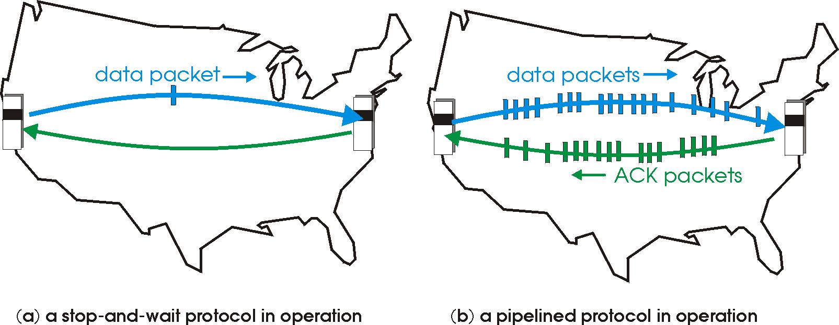
rdt3.0: pipelined protocols operation
pipelining: sender allows multiple, “in-flight”, yet-to-be-acknowledged packets
range of sequence numbers must be increased
buffering at sender and/or receiver
Notes:
Allow multiple packets to be sent.

Slide 63
Pipelining: increased utilization
sender
receiver
first packet bit transmitted, t = 0
last bit transmitted, t = L / R
first packet bit arrives
RTT
last packet bit arrives, send ACK
last bit of 2nd packet arrives, send ACK
last bit of 3rd packet arrives, send ACK
ACK arrives, send next
packet, t = RTT + L / R
3-packet pipelining increases
utilization by a factor of 3!
Notes:
Two generic forms of pipelined protocols: go-Back-N, selective repeat
Here, we allow three packets.
Efficiency is significantly increased, but it’s completed.
RTT is a window.

Slide 64
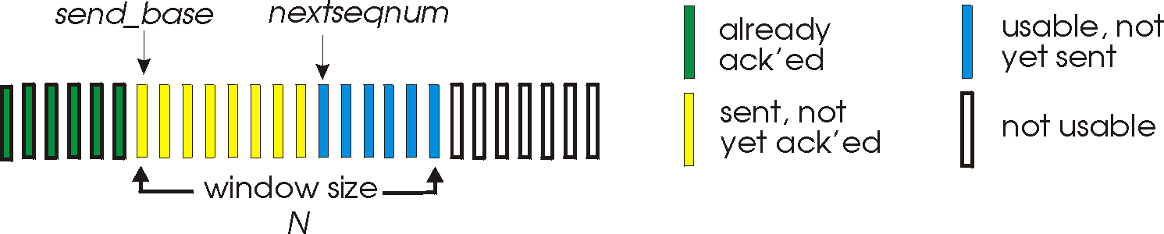
Go-Back-N: sender
sender: “window” of up to N, consecutive transmitted but unACKed pkts
k-bit seq # in pkt header
cumulative ACK: ACK(n): ACKs all packets up to, including seq # n
on receiving ACK(n): move window forward to begin at n+1
timer for oldest in-flight packet
timeout(n): retransmit packet n and all higher seq # packets in window
Notes:
Window sizes 14 and 8 have been sent but are not yet acknowledged, and six sequence numbers are available for us. In the window, but no calls from above to use them.
Note – we’ll skip the Go-Back-N FSM specification you can check that out in PowerPoint slides or book)
TCP uses cumulative ACK
Green is the packets which are already received properly.
Yellow: The packet is sent, but no acknowledgment from the receiver.
Blue: An additional packet that can be sent, but we haven’t sent it. (It's usable)
White: Even if we generate the packet, we cannot send it because it's not in the window.
Acknowledge will be a bit different. We only acknowledgment the packets which are received in order.
1 – Ack 1
2 – Ack-2
3 – Not received
4 – Ack 2 (Last packet correctly received and in order)
Acknowledged packet will not be in the window.

Slide 65
Go-Back-N: receiver
ACK-only: always send ACK for correctly-received packet so far, with highest in-order seq #
may generate duplicate ACKs
need only remember rcv_base
on receipt of out-of-order packet:
can discard (don’t buffer) or buffer: an implementation decision
re-ACK pkt with highest in-order seq #
Receiver view of sequence number space:
received and ACKed
…
…
Out-of-order: received but not ACKed
rcv_base
Not received
Notes:
Note – we’ll skip the Go-Back-N FSM specification (actually it’s
When the packet with gray color is received, then we acknowledge the gray packet and all the next pink packets,.
Pink: Packets that have arrived but are not in order (The gray packet in the middle is missing).

Slide 66
Go-Back-N in action
sender window (N=4)
sender
receiver
0 1 2 3 4 5 6 7 8
send pkt0
send pkt1
send pkt2
send pkt3
(wait)
0 1 2 3 4 5 6 7 8
receive pkt0, send ack0
receive pkt1, send ack1
receive pkt3, discard,
(re)send ack1
0 1 2 3 4 5 6 7 8
X
0 1 2 3 4 5 6 7 8
loss
0 1 2 3 4 5 6 7 8
rcv ack0, send pkt4
0 1 2 3 4 5 6 7 8
rcv ack1, send pkt5
receive pkt4, discard,
(re)send ack1
ignore duplicate ACK
receive pkt5, discard,
(re)send ack1
pkt 2 timeout
0 1 2 3 4 5 6 7 8
send pkt2
send pkt3
send pkt4
send pkt5
0 1 2 3 4 5 6 7 8
0 1 2 3 4 5 6 7 8
rcv pkt2, deliver, send ack2
rcv pkt3, deliver, send ack3
rcv pkt4, deliver, send ack4
rcv pkt5, deliver, send ack5
0 1 2 3 4 5 6 7 8
Notes:
Let’s skip FSM specification for GBN – check out the book or ppt – and let’s watch GBN sender and receivers in action.
Let assume a window size of 4. at t=0, sender sends packets 0, 1, 2 3, 4, and packet 2 will be lost
At the receiver:
Packet 0 received ACK0 generated
Packet 1 received ACK1 generated
Packet 2 is lost, and so when packet 3 is received, ACK 1 is sent – that’s the cumulative ACK, re-Acknowledging the receipt of packet 1. and in this implementation packet 3 is discarded

Slide 67
Selective repeat: the approach
pipelining: multiple packets in flight
receiver individually ACKs all correctly received packets
buffers packets, as needed, for in-order delivery to upper layer
sender:
maintains (conceptually) a timer for each unACKed pkt
timeout: retransmits single unACKed packet associated with timeout
maintains (conceptually) “window” over N consecutive seq #s
limits pipelined, “in flight” packets to be within this window
Notes:
An important mechanism of GBN was the use of the cumulative acknowledgements, and as we mentioned, cumulative ACKs are used in TCP
An alternate ACK mechanism would be for the receiver to individually acknowledge specific packets as they are received. This mechanism is at the heart of the Selective repeat protocol.

Slide 68
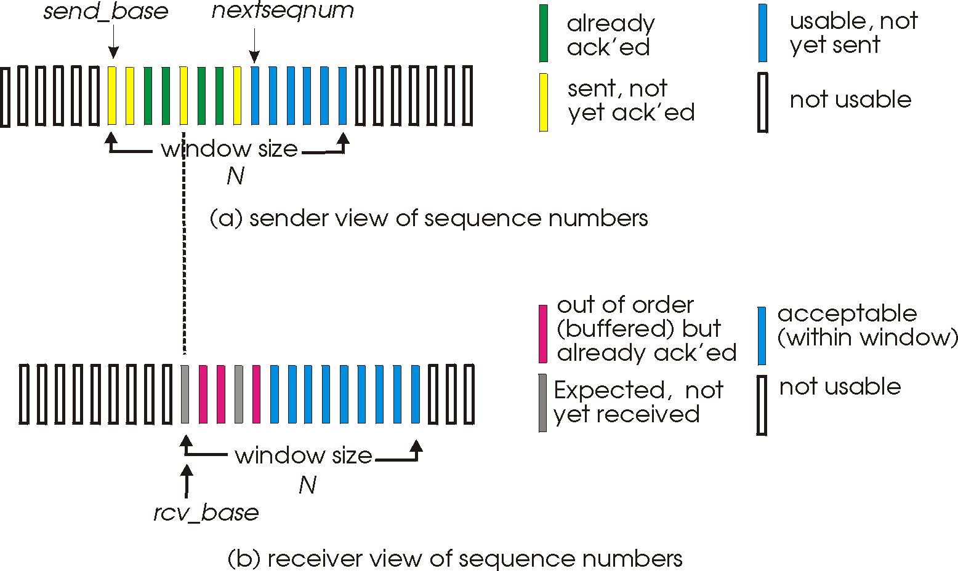
Selective repeat: sender, receiver windows
Notes:
We will move the window only if we receive the packet in the correct order.

Slide 69
Selective repeat: sender and receiver
sender
receiver
data from above:
if next available seq # in window, send packet
timeout(n):
resend packet n, restart timer
ACK(n) in [sendbase,sendbase+N-1]:
mark packet n as received
if n smallest unACKed packet, advance window base to next unACKed seq #
packet n in [rcvbase, rcvbase+N-1]
send ACK(n)
out-of-order: buffer
in-order: deliver (also deliver buffered, in-order packets), advance window to next not-yet-received packet
packet n in [rcvbase-N,rcvbase-1]
ACK(n)
otherwise:
ignore
Notes:
If the packet is in order, its data will be delivered, as will any buffered data that can now be delivered in order
If we have a window of 10 packets, we need to have 10 timers.
Implementation is simple in Go-back N when compared to selective repeat.
Selective repeat is reliable when compared to go back n.

Slide 70
Selective Repeat in action
sender window (N=4)
sender
receiver
0 1 2 3 4 5 6 7 8
send pkt0
send pkt1
send pkt2
send pkt3
(wait)
0 1 2 3 4 5 6 7 8
receive pkt0, send ack0
receive pkt1, send ack1
receive pkt3, buffer,
send ack3
0 1 2 3 4 5 6 7 8
X
0 1 2 3 4 5 6 7 8
loss
0 1 2 3 4 5 6 7 8
rcv ack0, send pkt4
0 1 2 3 4 5 6 7 8
rcv ack1, send pkt5
receive pkt4, buffer,
send ack4
record ack3 arrived
receive pkt5, buffer,
send ack5
pkt 2 timeout
0 1 2 3 4 5 6 7 8
send pkt2
(but not 3,4,5)
0 1 2 3 4 5 6 7 8
0 1 2 3 4 5 6 7 8
rcv pkt2; deliver pkt2,
pkt3, pkt4, pkt5; send ack2
0 1 2 3 4 5 6 7 8
Q: what happens when ack2 arrives?

Slide 71
Selective repeat: a dilemma!
sender window
(after receipt)
receiver window
(after receipt)
0 1 2 3 0 1 2
pkt0
0 1 2 3 0 1 2
pkt1
0 1 2 3 0 1 2
0 1 2 3 0 1 2
pkt2
0 1 2 3 0 1 2
example:
seq #s: 0, 1, 2, 3 (base 4 counting)
window size=3
0 1 2 3 0 1 2
0 1 2 3 0 1 2
pkt3
X
0 1 2 3 0 1 2
pkt0
will accept packet
with seq number 0
(a) no problem
0 1 2 3 0 1 2
pkt0
0 1 2 3 0 1 2
pkt1
0 1 2 3 0 1 2
0 1 2 3 0 1 2
pkt2
X
0 1 2 3 0 1 2
X
0 1 2 3 0 1 2
X
timeout
retransmit pkt0
0 1 2 3 0 1 2
pkt0
will accept packet
with seq number 0
(b) oops!

Slide 72

Selective repeat: a dilemma!
sender window
(after receipt)
receiver window
(after receipt)
0 1 2 3 0 1 2
pkt0
0 1 2 3 0 1 2
pkt1
0 1 2 3 0 1 2
0 1 2 3 0 1 2
pkt2
0 1 2 3 0 1 2
example:
seq #s: 0, 1, 2, 3 (base 4 counting)
window size=3
0 1 2 3 0 1 2
0 1 2 3 0 1 2
pkt3
X
0 1 2 3 0 1 2
receiver can’t see sender side
receiver behavior identical in both cases!
something’s (very) wrong!
pkt0
will accept packet
with seq number 0
(a) no problem
Q: what relationship is needed between sequence # size and window size to avoid problem in scenario (b)?
pkt0
0 1 2 3 0 1 2
0 1 2 3 0 1 2
pkt1
0 1 2 3 0 1 2
0 1 2 3 0 1 2
pkt2
X
0 1 2 3 0 1 2
X
0 1 2 3 0 1 2
X
timeout
retransmit pkt0
0 1 2 3 0 1 2
pkt0
will accept packet
with seq number 0
(b) oops!

